Slide 1
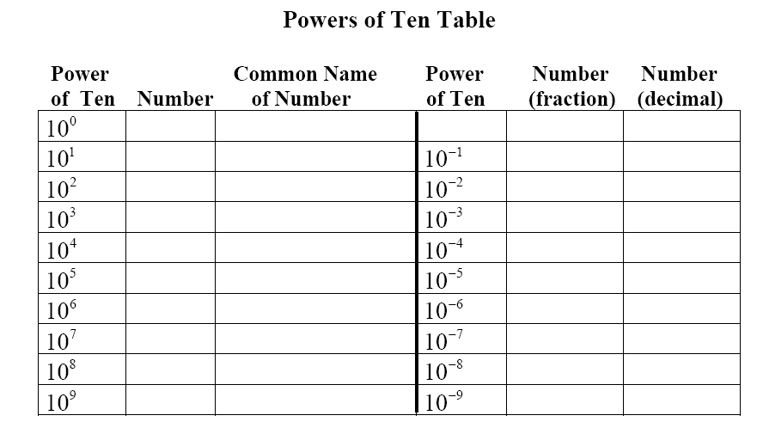
Complete the Following Table
Notes:
From MathScape Green “Family Portraits” – Lesson 12 p. 300A Part 1

Slide 2
From the Previous Table…
What patterns do you notice in the table?
How can you tell how many zeros are in a number based on the power of 10?
Notes:
From MathScape Green “Family Portraits” – Lesson 12 p. 300A Part 2

Slide 3
How wide is our universe?
210,000,000,000,000,000,000,000 miles
(22 zeros)
This number is written in standard notation. When numbers get this large, it is easier to write them in scientific notation.

Slide 4
Does anyone remember how to write a number in
SCIENTIFIC NOTATION
based on your science class or 6th grade math class?

Slide 5
Scientific Notation
A number is expressed in scientific notation when it is in the form
a x 10^{n}
where a is between 1 and 10
and n is an integer
Notes:
From MathScape Green “Family Portraits” – Lesson 12 p. 300A Part 3

Slide 6
Write the width of the universe in scientific notation.
210,000,000,000,000,000,000,000 miles
Where is the decimal point now?
After the last zero.
Where would you put the decimal to make this number be between 1 and 10?
Between the 2 and the 1

Slide 7
2.10,000,000,000,000,000,000,000.
How many decimal places did you move the decimal?
23
When the original number is more than 1, the exponent is positive.
The answer in scientific notation is
2.1 x 10²³

Slide 8
1) Express 0.0000000902 in scientific notation.
Where would the decimal go to make the number be between 1 and 10?
9.02
The decimal was moved how many places?
8
When the original number is less than 1, the exponent is negative.
9.02 x 10⁻⁸

Slide 9
Write 28750.9 in scientific notation.
2.87509 x 10⁻⁵
2.87509 x 10⁻⁴
2.87509 x 10⁴
2.87509 x 10⁵

Slide 10
2) Express 1.8 x 10⁻⁴ in standard notation.
0.00018
3) Express 4.58 x 10⁶ in standard notation.
4,580,000

Slide 11
Scientific Notation Examples
Determine whether each of the following numbers is written in scientific notation? Explain.

Slide 12
Scientific Notation
Write each number in scientific notation.
4) 62,400
5) 0.00085
6) 1,602,000

Slide 13
Standard Notation
Write each number in standard notation.

Slide 14
What does Scientific Notation look like on a calculator?
Enter any 8-digit number into your calculator.
Next, multiply by a 4-digit number.
What do you see?
Notes:
Discuss the various ways scientific notation can be shown and entered on a calculator.
In working with calculators or spreadsheets, it is important that students recognize scientific notation. Students should recognize that the output of 2.45E+23 is 2.45 x 10²³ and 3.5E-4 is 3.5 x 10⁻⁴. Students enter scientific notation using E or EE (scientific notation), * (multiplication), and ^ (exponent) symbols.

