Slide 1
Biotechnology Notes

Slide 2
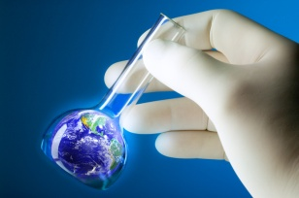
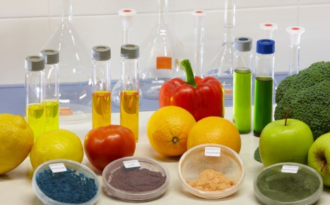
Biotechnology is…
the use of living substances to make living organisms or parts of living organisms.
a quickly growing field with many questions and ethical issues associated with it.
an increase in job opportunities in the research field.
the use of living organisms to produce food, drugs or other items.

Slide 3
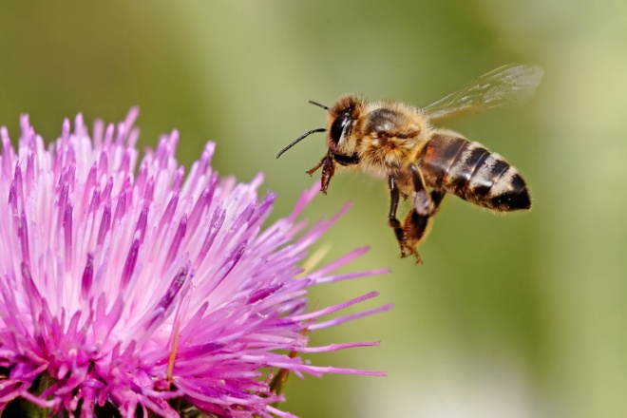
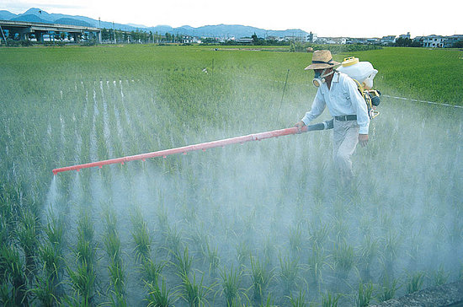
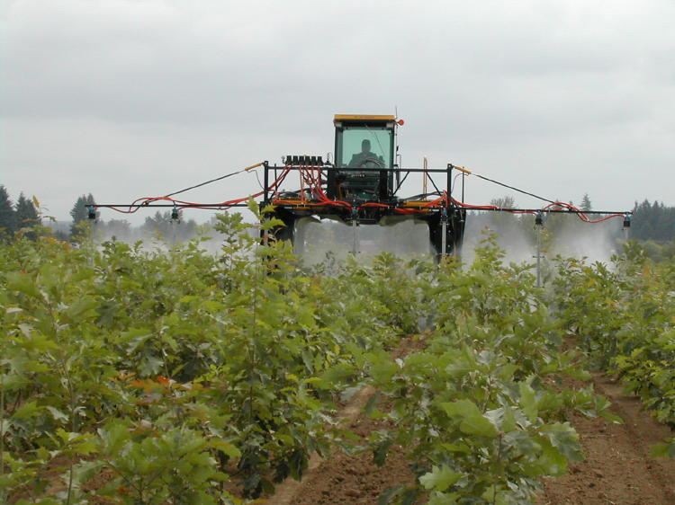
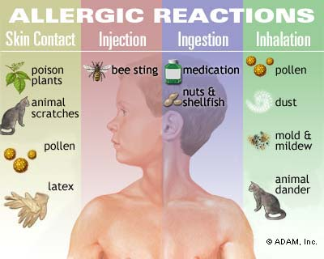
A type of Biotechnology: GMO GMO’s can lead to…
increased deaths of helpful insects. (such as pollinators – bees)
Reduced effectiveness to pesticides
Genes for herbicide resistance might be transferred to weeds by cross-pollination.
allergies

Slide 4
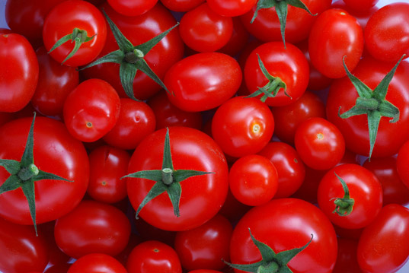
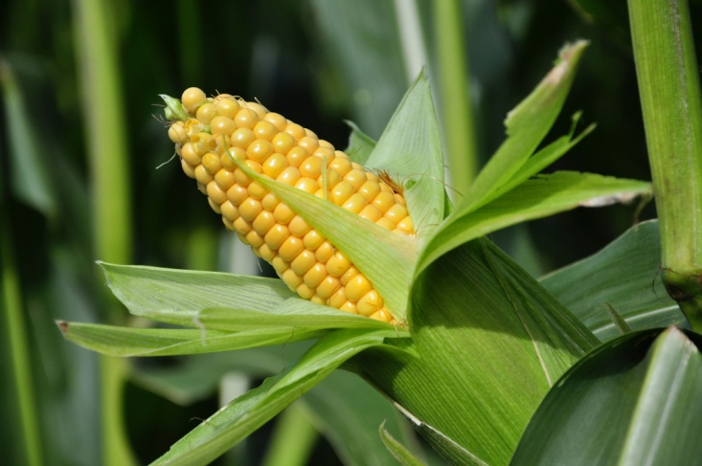
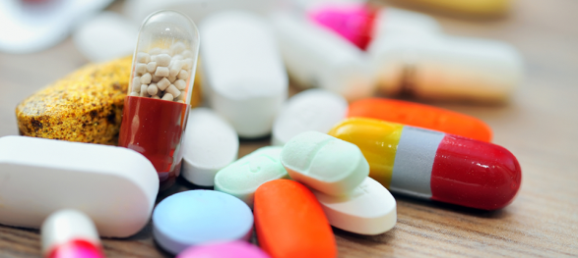
GMO’s can lead to…
Cross-pollination with wild plants.
can cause unknown diseases in humans.
Pest resistance
Herbicide, cold, salinity/salt and drought tolerance
Nutrition – nutrients added
Pharmaceutical medicines and vaccines

Slide 5
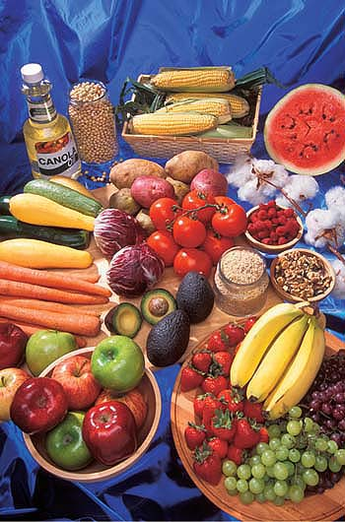
Transgenic Crops
A plant contains a gene or genes which have been artificially inserted instead of the plant acquiring them through pollination
can cross pollinate with wild plants.
can cause allergies in humans.
can cause unknown diseases in humans.

Slide 6
Modern Biotechnology
Uses genetically engineered organisms to produce antibiotics (or other pharmaceuticals)
Creates liquid fuels from organic matter
Example – biofuel – ethanol (from corn)
Corn is used the most in biotechnology
Ethical concerns should be considered when creating or changing living organisms
Changing the genetic makeup of an organism is called genetic engineering

Slide 7
Stem Cells
Can develop into any different cell type in the body during early life and growth
Types: embryonic stem cells and adult stem cells
embryonic stem cells – come from blastocysts; formed about 5 days after fertilization
adult stem cells– come from various tissues in adults

